Slide 1


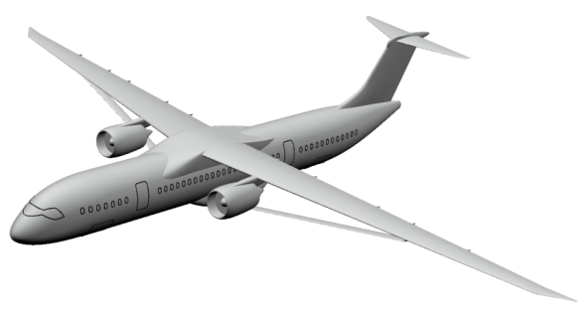

PLATFORM FOR AIRCRAFT DRAG REDUCTION INNOVATION
Local flow control for the strut braced wing (SBW)
Results Comparison
KNOW MORE ABOUT
CIMNE’s MISSION

Slide 2
contributions
Team | Title | Presenter | Co-authors
INCAS, Romania | Investigations of passive flow control devices for wave drag reduction | M.G. Cojocaru | D. Pepelea, M.V. Pricop, C. Nae, M.G. Stoican, M.L. Niculescu
NASA Ames, USA | NASA Ames contributions to the PADRI workshop | Gaetan Kenway | Jeffery Houseman, Cetin Kiris
NASA Langley, USA | Application of a Knowledge-Based Design Method and Passive Porosity for Drag Reduction on a Generic Strut-Braced Wing | Richard Campbell | Sally Viken, Michelle Lynde
Tsinghua University | PADRI: Shock Wave Reduction via Wing-Strut Geometry Design | Runze LI | Yufei ZHANG, Haixin CHEN, Song FU
Univ. of Concepción, Chile | Drag reduction in a wing-strut junction | Pablo Cornejo
Stanford Univ. | Contribution to Padri | Juan Alonso | Brian Munguia, Victorien Menier, Jayant Mukhopadhaya.
DLR |  | Nico Bier | J.P.Hofmann

Slide 3
contributions
Team | Flow Control Device | Type of FC devices | Summary in two words
INCAS, Romania | Kuchemann Carrot (KC) and shock control bumps (SCB) | Passive device | No improvement obtained, so optimization required.
NASA Ames, USA | No Flow control Device: geometry modification | -- | Optimization of truss shape. SQP optimizer.
NASA Langley, USA | 1. No Flow control Device: geometry modification 2. Porous media | 1. -- 2. Passive device | Reduction of shock, separation and drag 2. Reduction of shock but increase on BL separation
Tsinghua University, China | No Flow control Device: geometry modification | -- | Shock wave reduction obtained
Univ. of Concepción, Chile | SCB + air injectors | Passive + active Devices | Drag reduction between 3.6-5.6 drag counts, power saved around 165kW
Stanford Univ. | Blowing and suction (Transpiration bc) | Active device
DLR | Fluidic Gurney | Active device | 10% drag reduction

Slide 4
contributions
Team | Solver | Mesh elements | Mesh size | Turbulence model
INCAS, Romania | RANS (Ansys Fluent) | hexahedral | ~95M | k-ω SST with Intermittency Transition model
NASA Ames, USA | RANS (ADflow) |  | ~7.5M ~60M
NASA Langley, USA | RANS (USM3D) | tetrahedral | ~60M
THU, China | RANS (NSAWET) | Structured grid | ~10M | k-ω SST
UdeC, Chile | RANS (Ansys Fluent) | Hexahedral and polyhedral | ~20M | k-ω SST
Stanford Univ. | RANS (SU2 framework) | Unstructured Grid (Prisms, ...) | ~10M | k-ω SST
DLR | RANS (Tao)

Slide 5
contributions
Team | Optimizer | Type | Number of iterations | Computational time
INCAS, Romania | -- | --
NASA Ames, USA | SQP | Gradient based method |  | 2h (480 cores)
NASA Langley, USA | CDISC | knowledge-based design method
THU, China | 2D optimization with GA | Stochastic method
UdeC, Chile | -- | --
Stanford Univ. | SU2 framework | Adjoint-based method
DLR

Slide 6
contributions
Team | Tecplot files | Shock Wave flag
INCAS, Romania | Surface only | No
NASA Ames, USA | Yes | Yes
NASA Langley, USA | Yes | Yes
THU, China | Yes | Yes
UdeC, Chile | No | No
Stanford Univ. | No | No
DLR | No | No

Slide 7
Questions
Baseline as a reference
Is lift maintained at the baseline value?
Robustness of the solution (Mach flexibility)
Adaptability of the solution to other Use Cases
Optimization analysis of the solution
Span loading; how is it affected? (wing + strut)

Slide 8
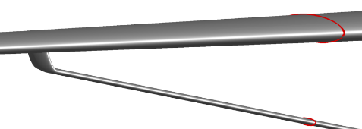
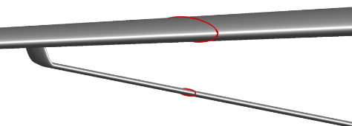
stations
Y12
Y14

Slide 9
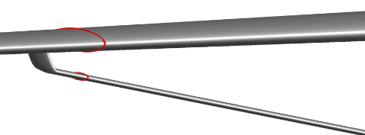
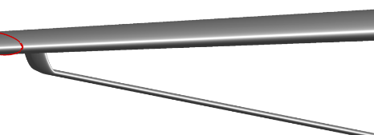
stations
Y16
Y17.3

Slide 10
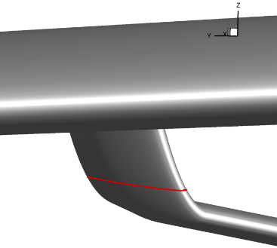
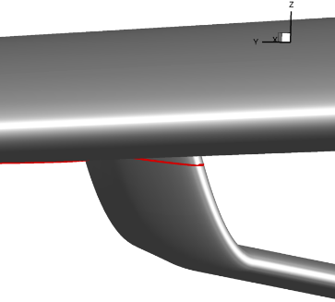
stations
Z0.87
Z1.07

Slide 11
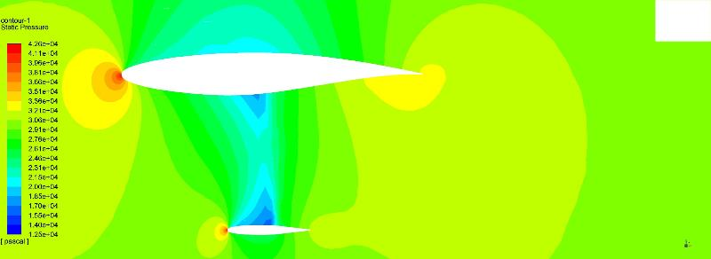
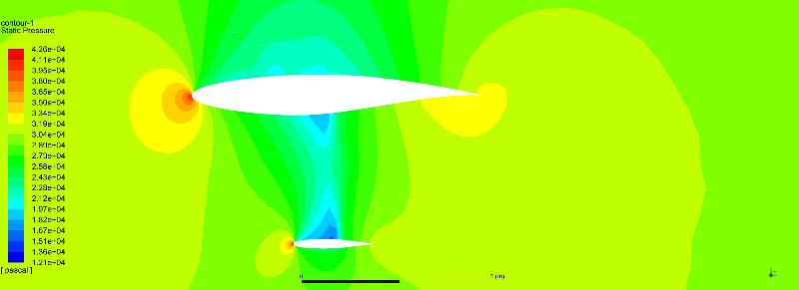
CP (station y12)
INCAS
KC
INCAS
SCB

Slide 12
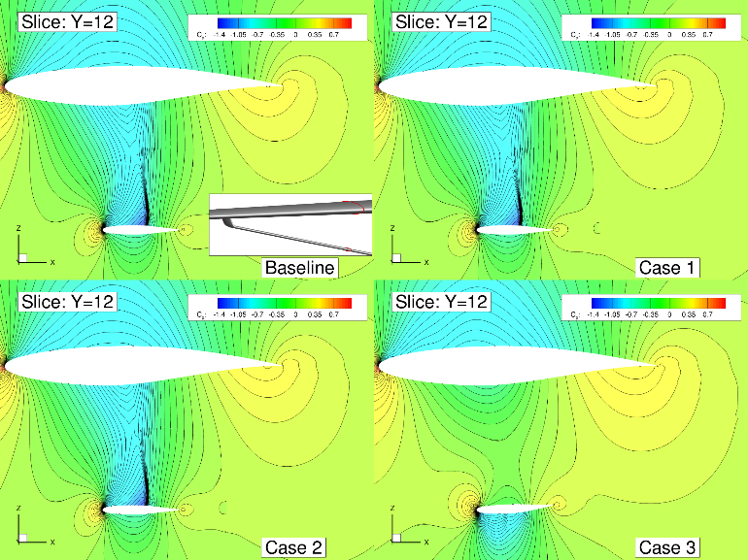
CP (station y12)
NASA-AMES

Slide 13
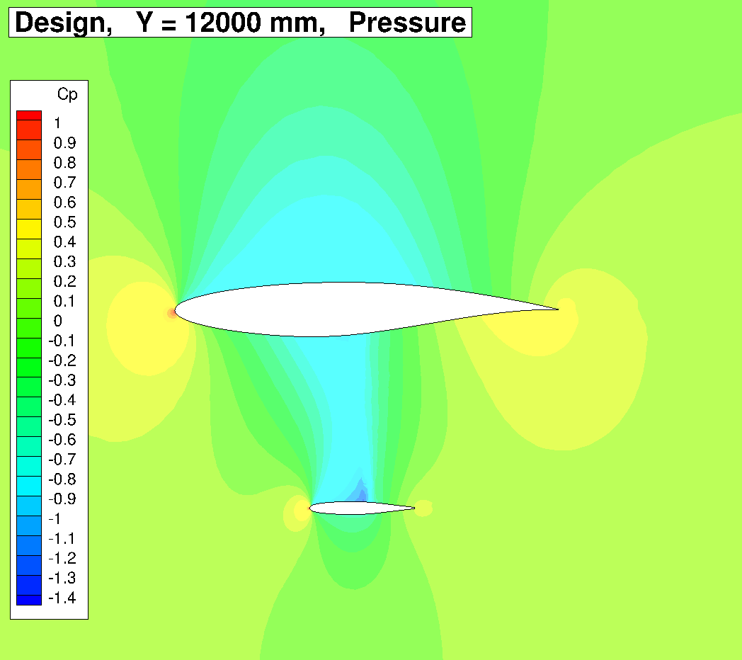
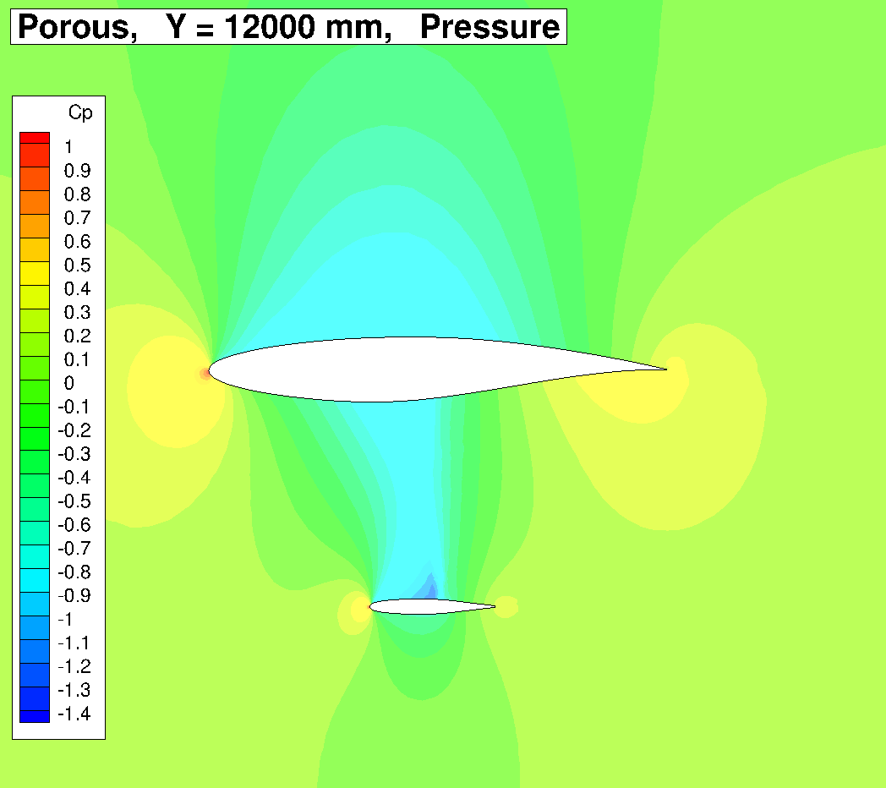
CP (station y12)
LANGLEY - Geometry
Porous

Slide 14
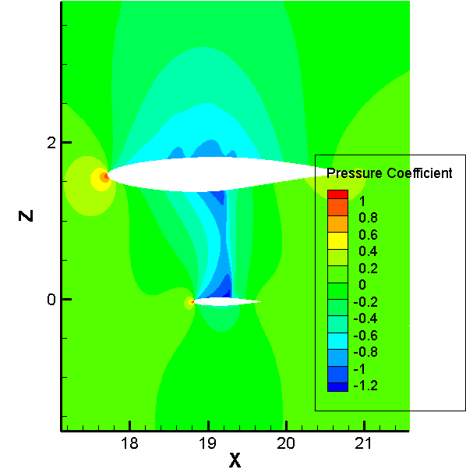
CP (station y12)
THU - Geometry

Slide 15
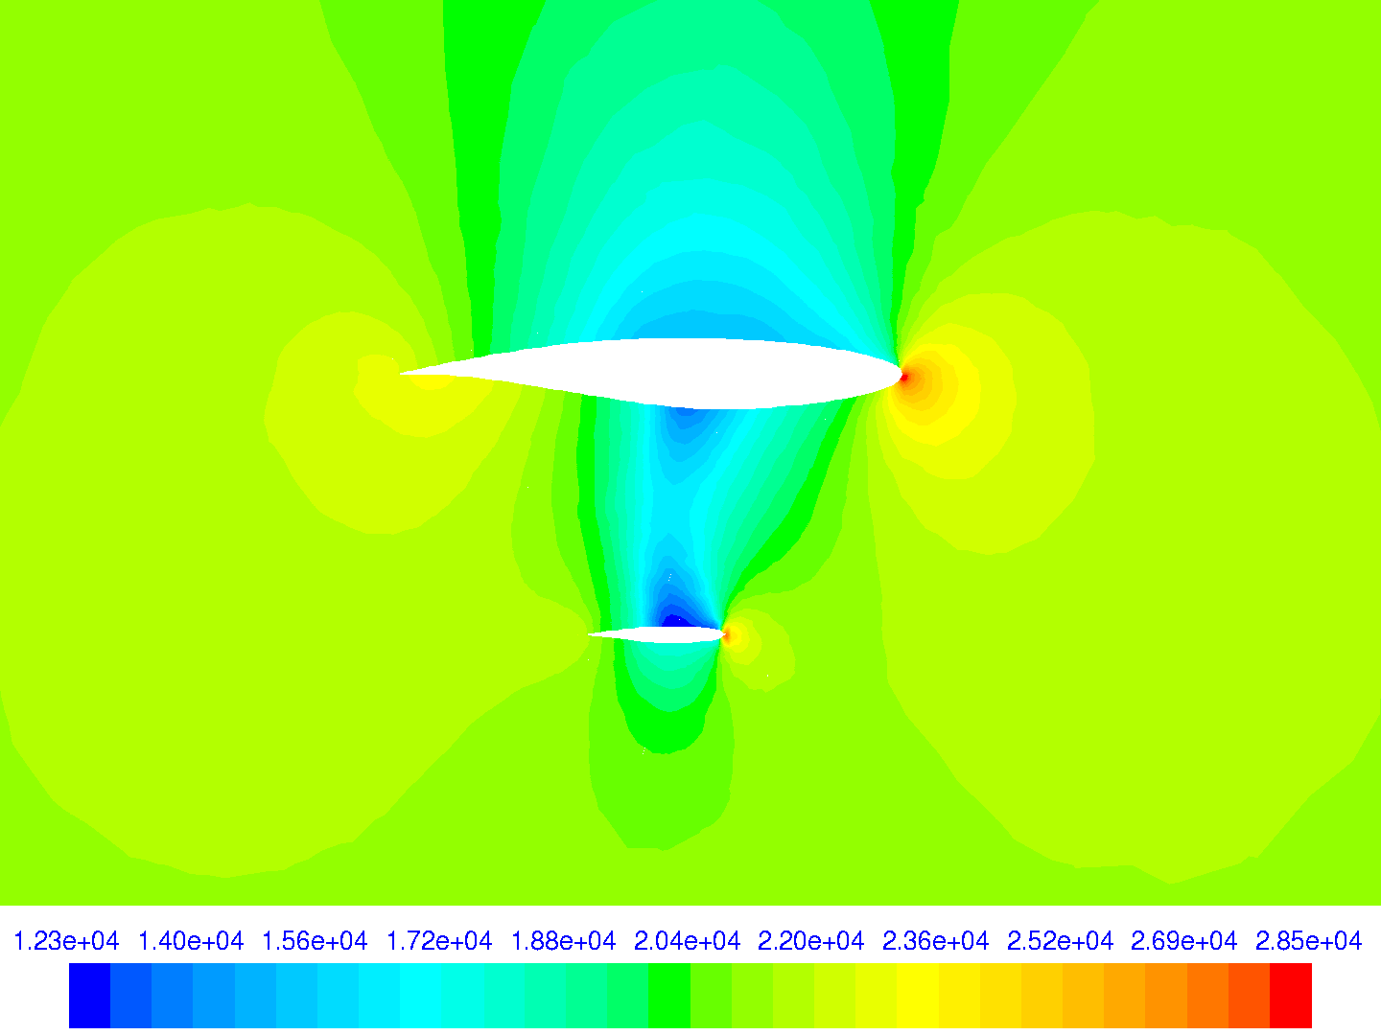
CP (station y12)
UdeC - SCB

Slide 16
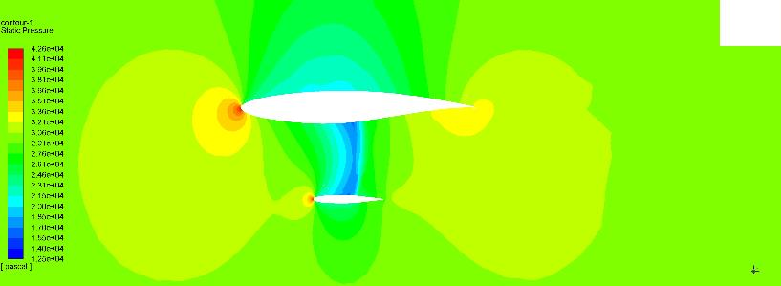
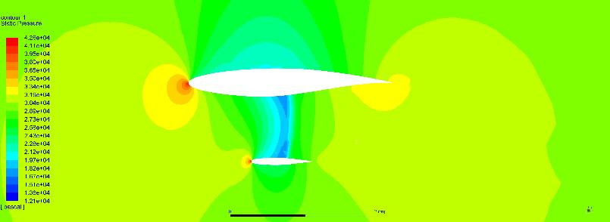
CP (station y14)
INCAS
KC
INCAS
SCB

Slide 17
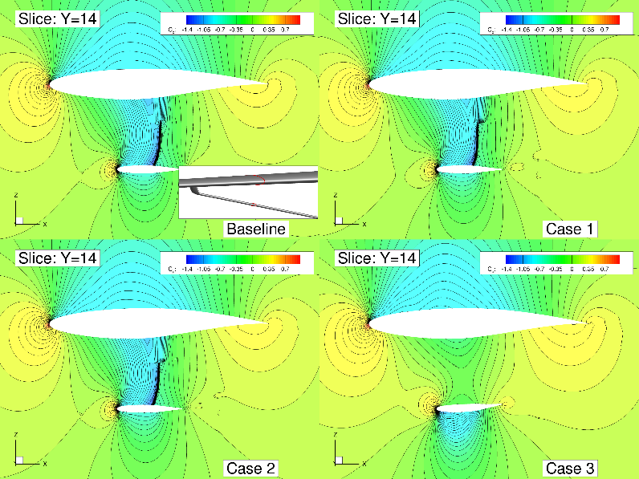
CP (station y14)
NASA-AMES

Slide 18
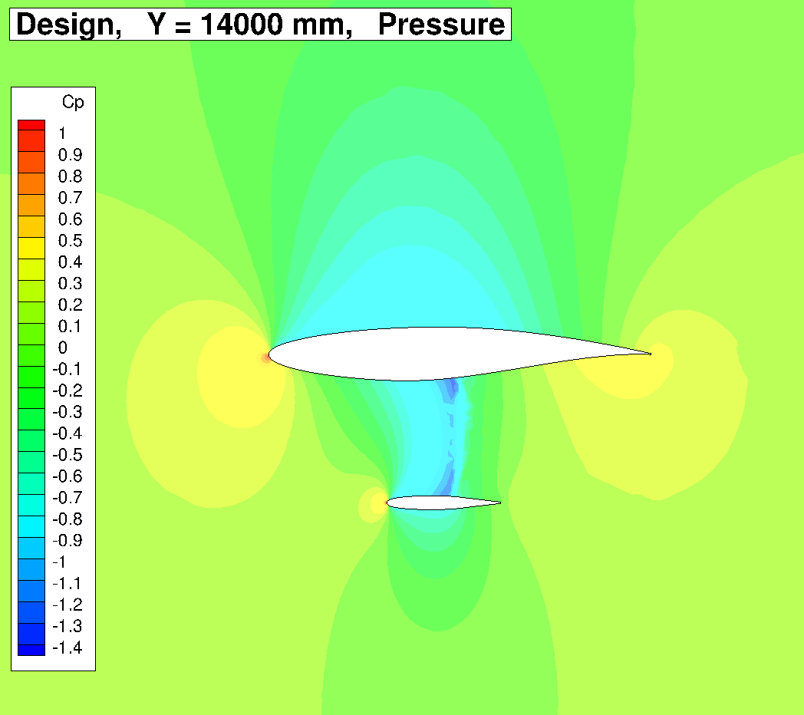
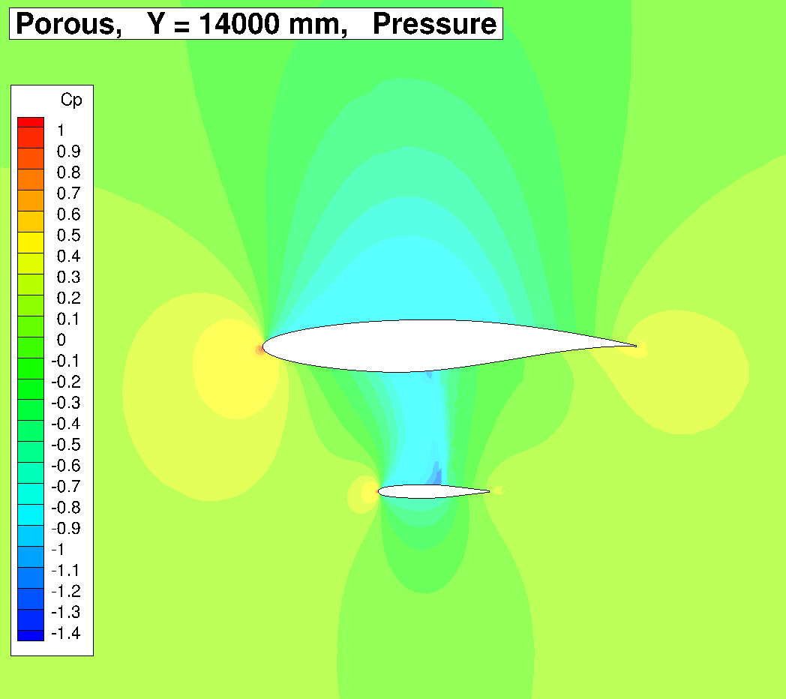
CP (station y14)
LANGLEY - Geometry
Porous

Slide 19
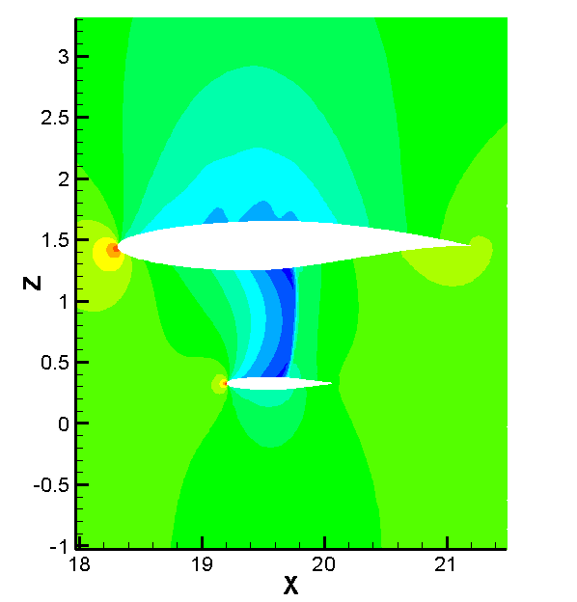
CP (station y14)
THU - Geometry

Slide 20
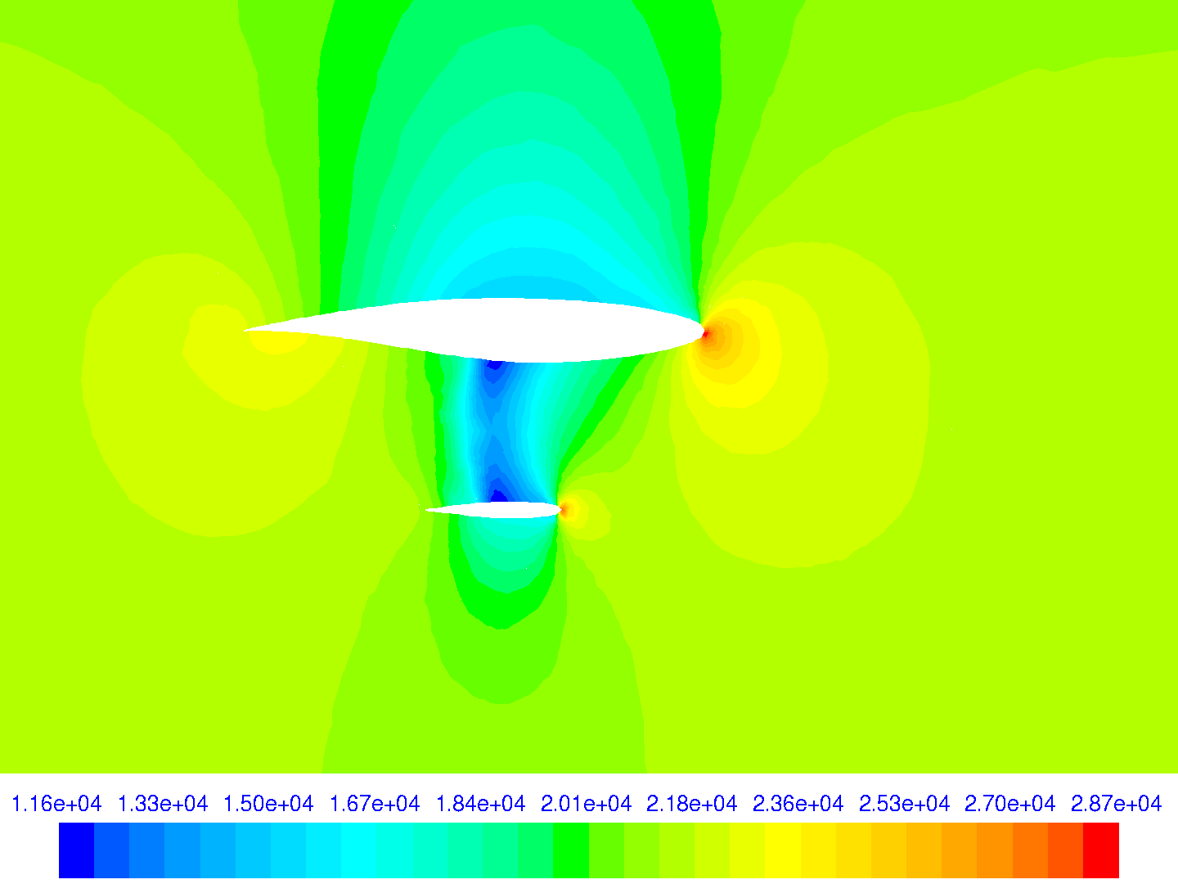
CP (station y14)
UdeC - SCB

Slide 21
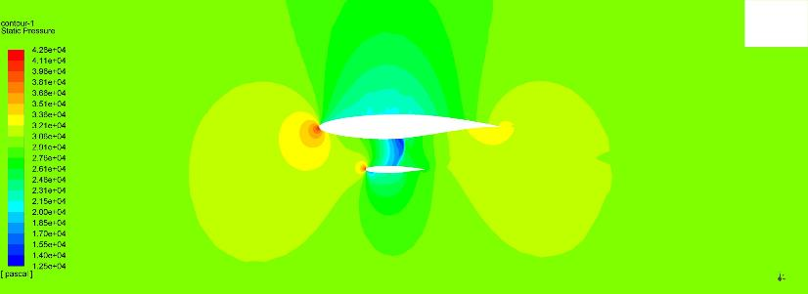
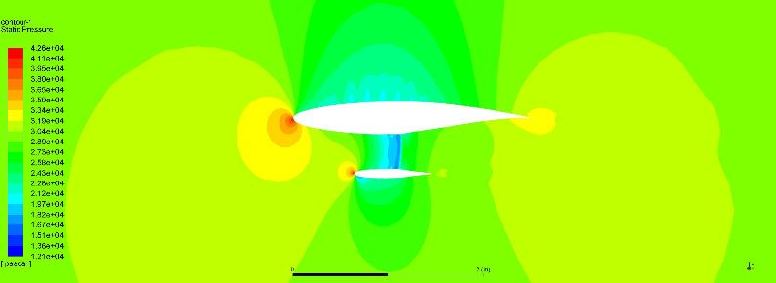
CP (station y16)
INCAS
KC
INCAS
SCB

Slide 22

CP (station y16)
NASA-AMES

Slide 23
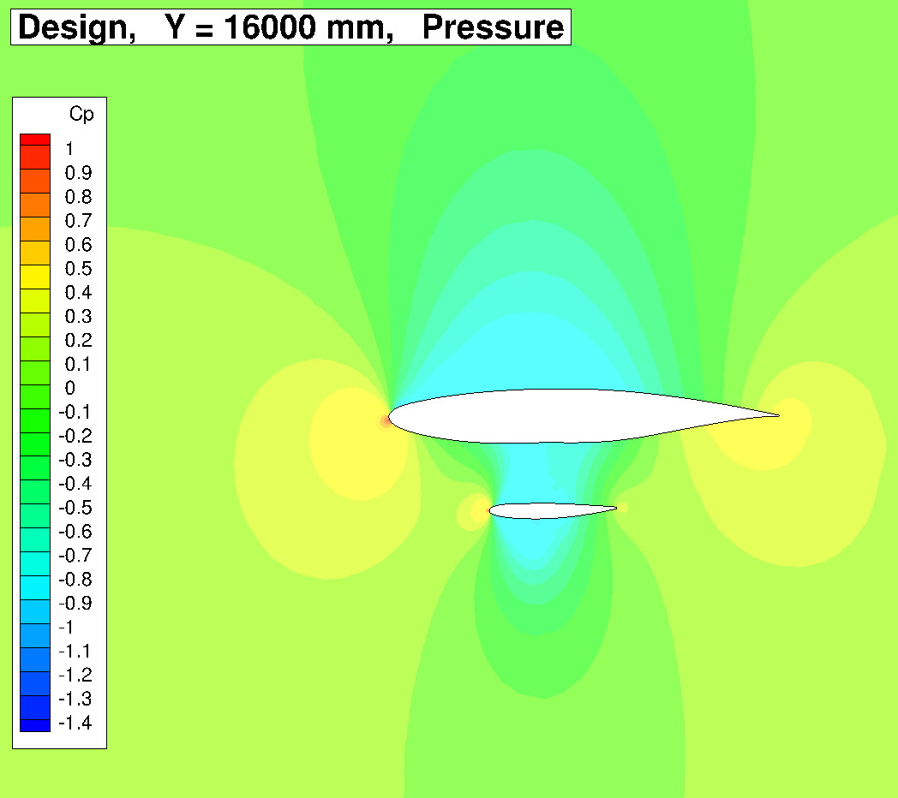
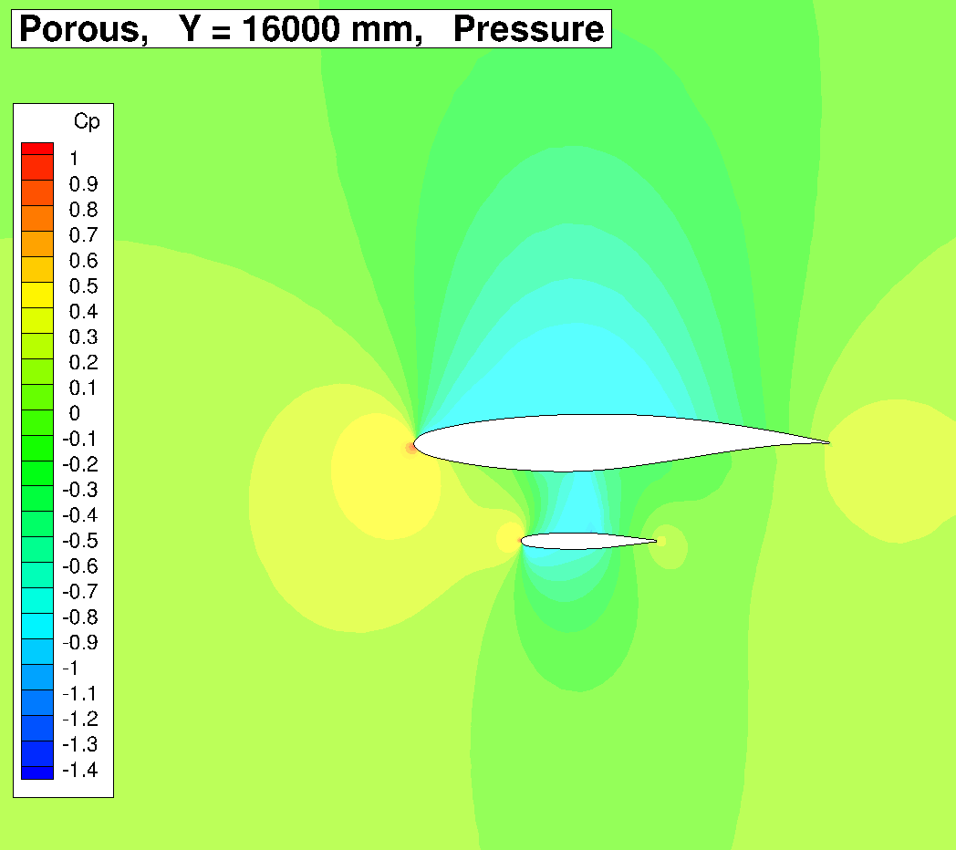
CP (station y16)
LANGLEY - Geometry
Porous

Slide 24
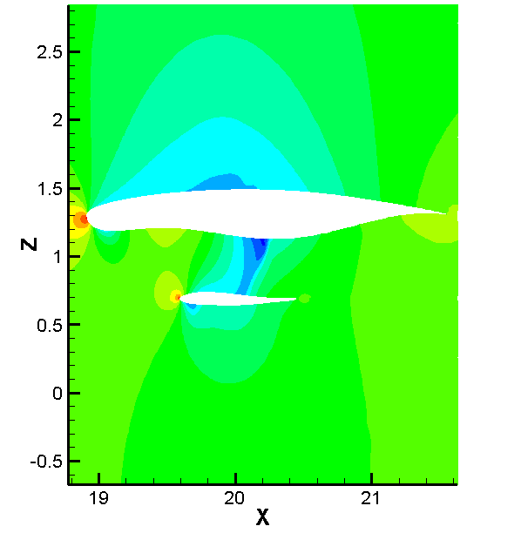
CP (station y16)
THU - Geometry

Slide 25
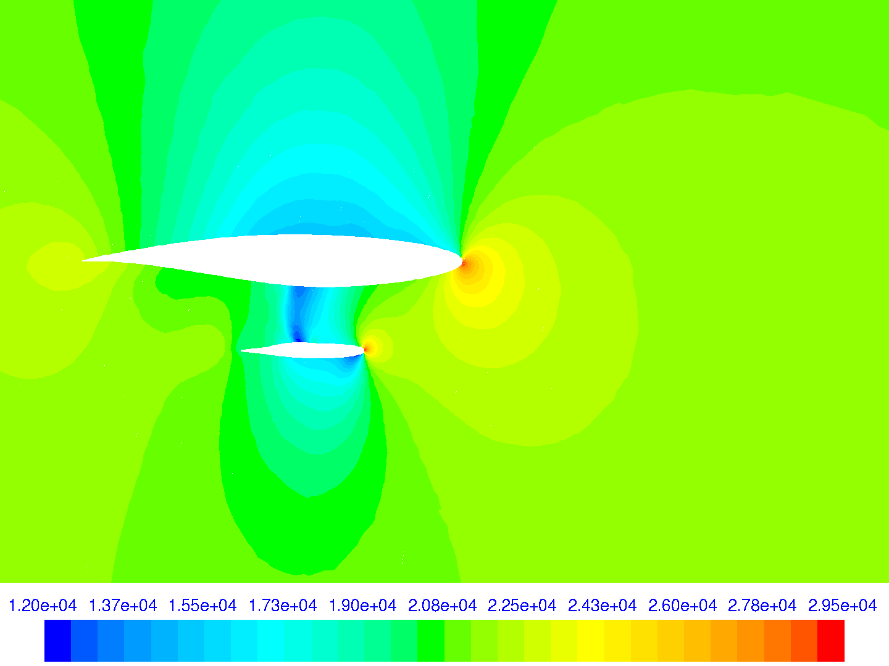
CP (station y16)
UdeC - SCB

Slide 26
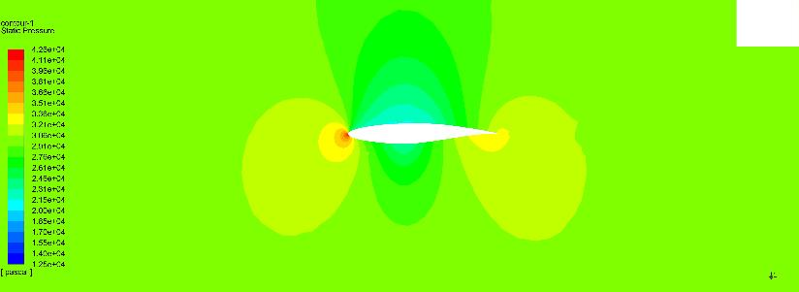
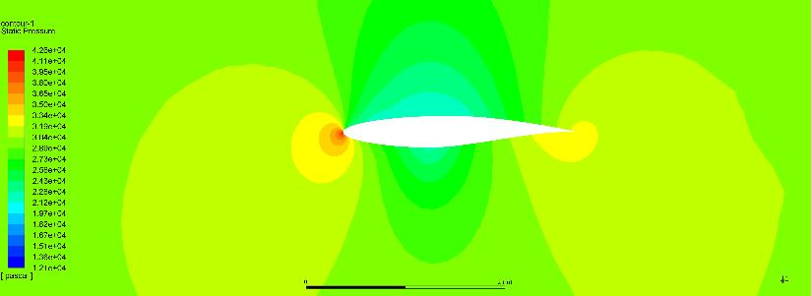
CP (station y17.3)
INCAS
KC
INCAS
SCB

Slide 27
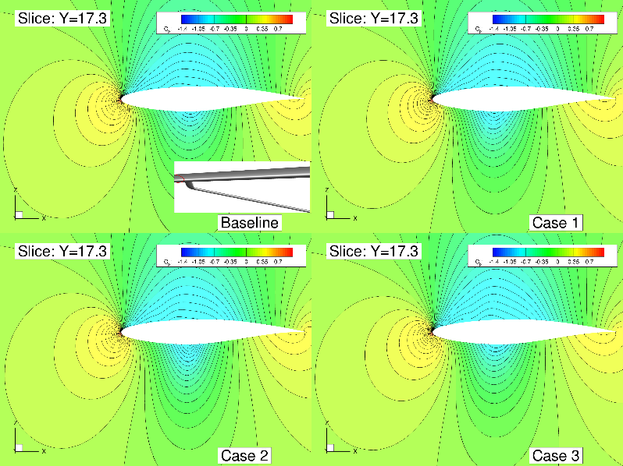
CP (station y17.3)
NASA-AMES

Slide 28
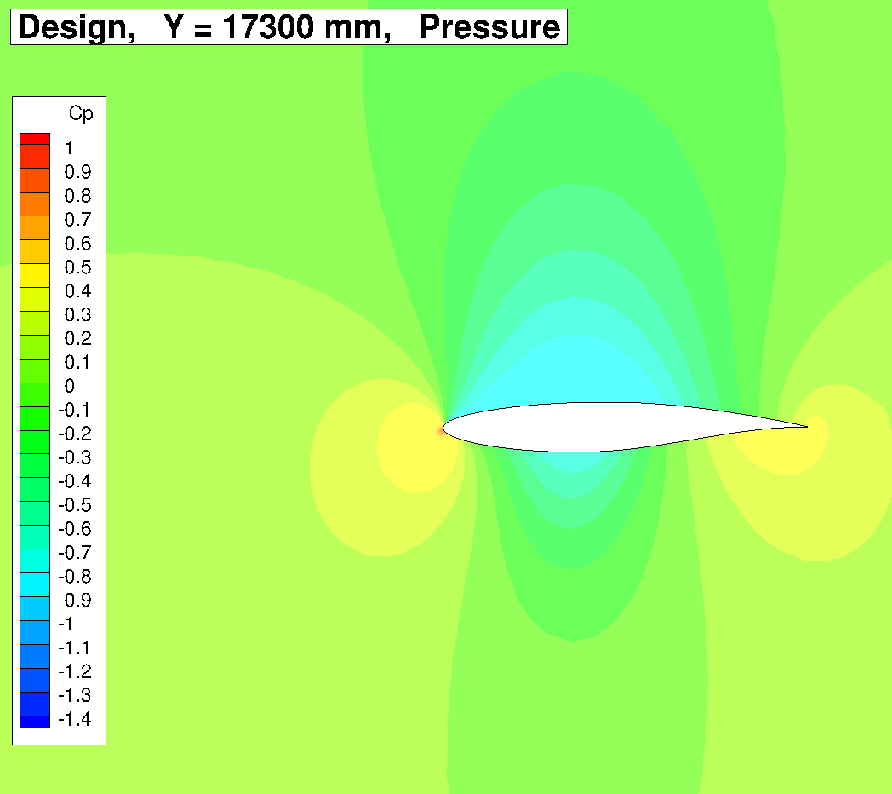
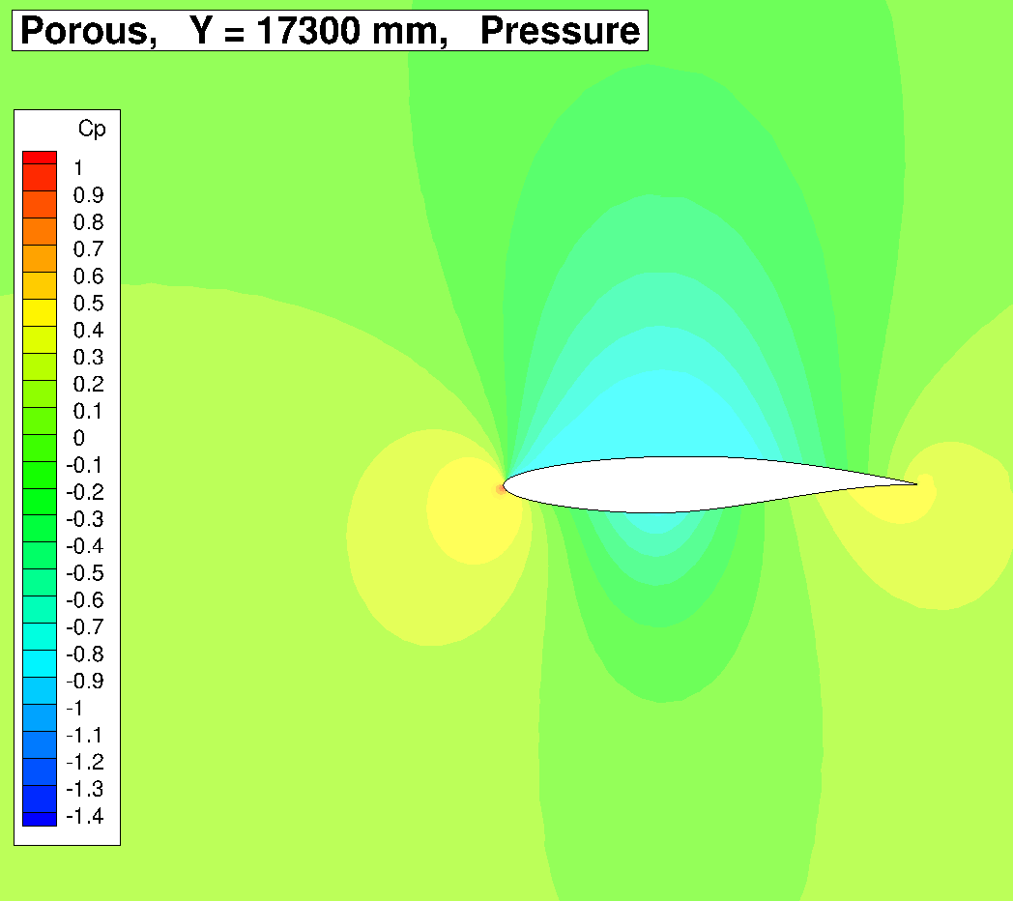
CP (station y17.3)
LANGLEY - Geometry
Porous

Slide 29
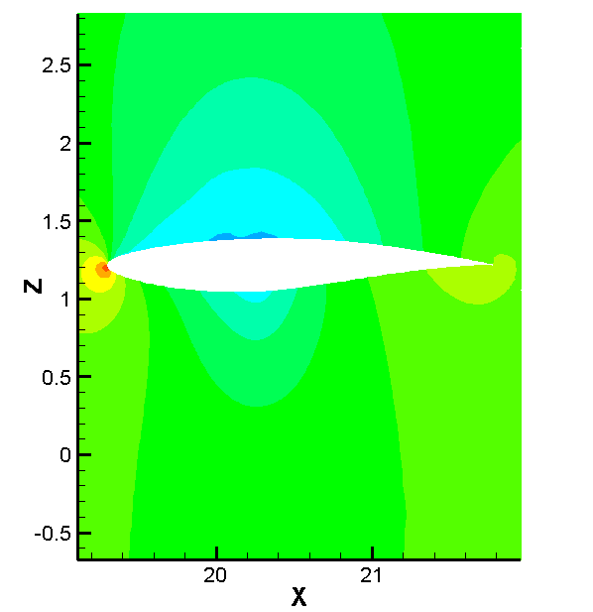
CP (station y17.3)
THU - Geometry

Slide 30
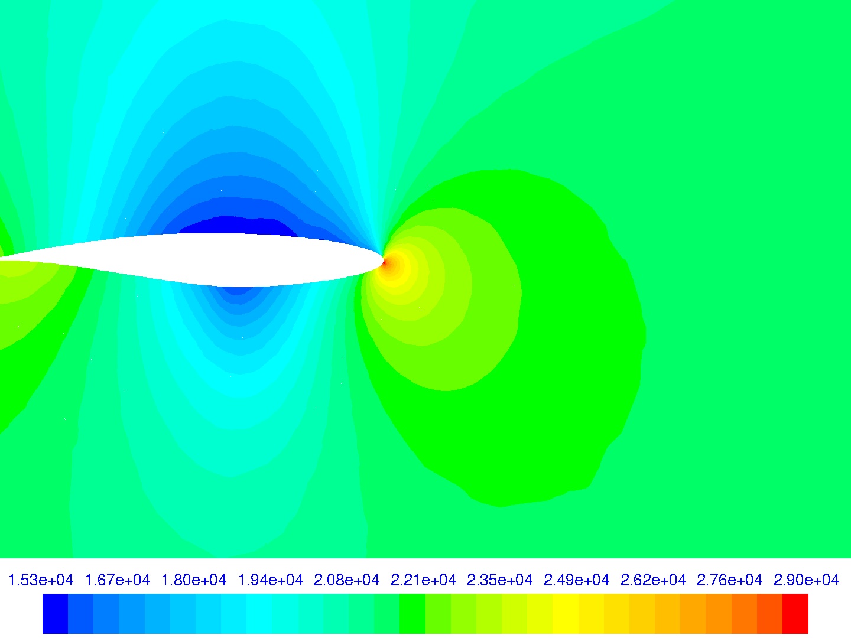
CP (station y17.3)
UdeC - SCB

Slide 31
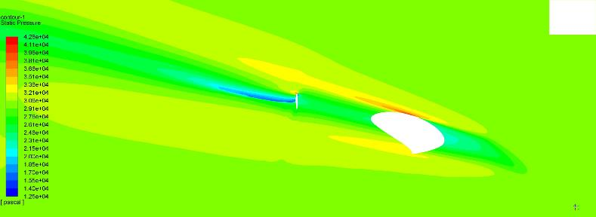
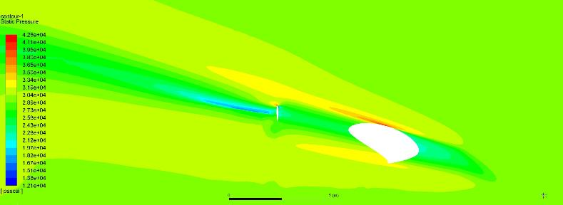
CP (station z0.87)
INCAS
KC
INCAS
SCB

Slide 32
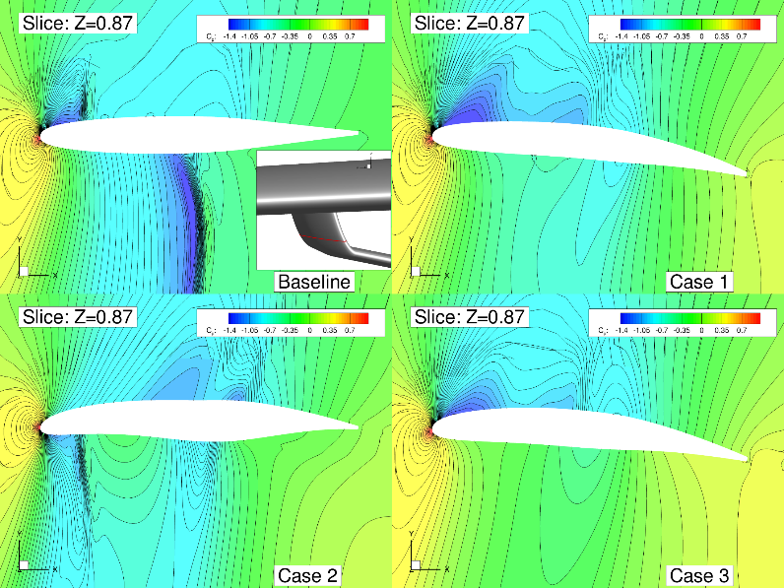
CP (station z0.87)
NASA-AMES

Slide 33
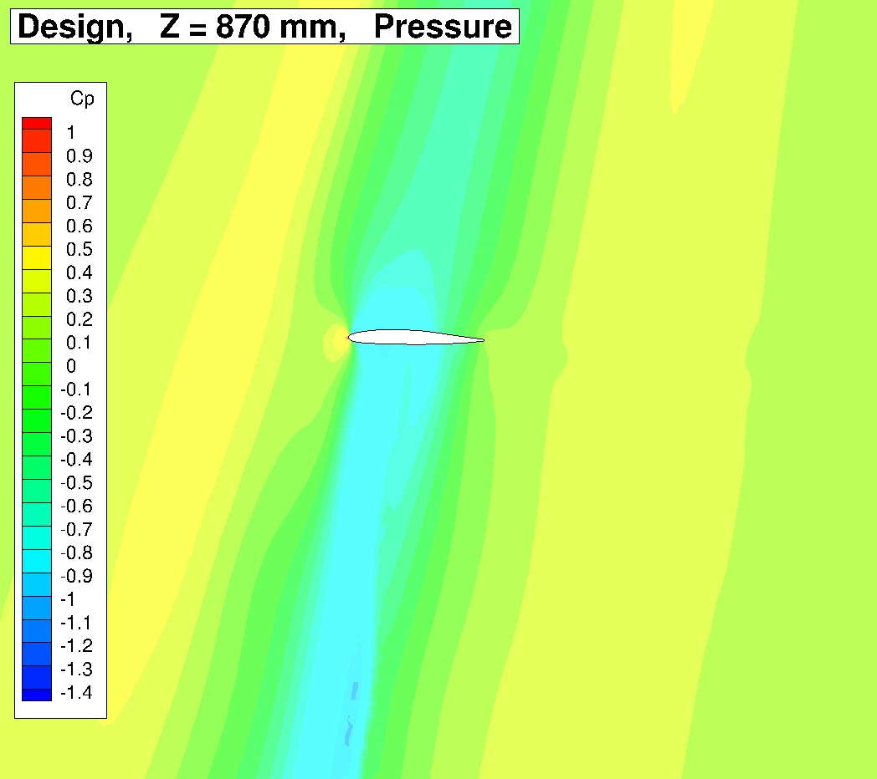
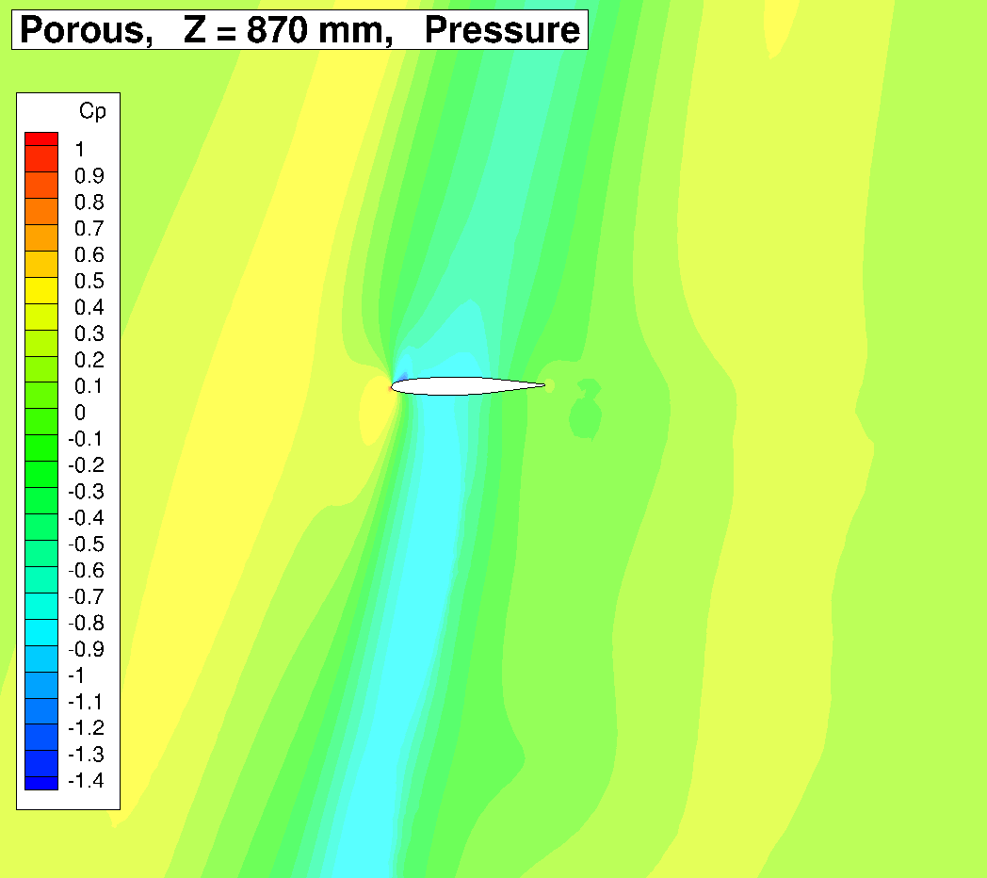
CP (station z0.87)
LANGLEY - Geometry
Porous

Slide 34
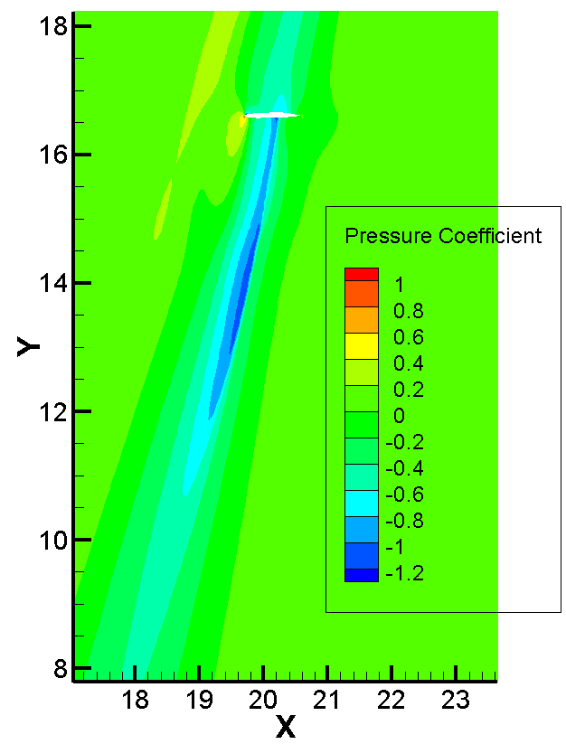
CP (station z0.87)
THU - Geometry

Slide 35
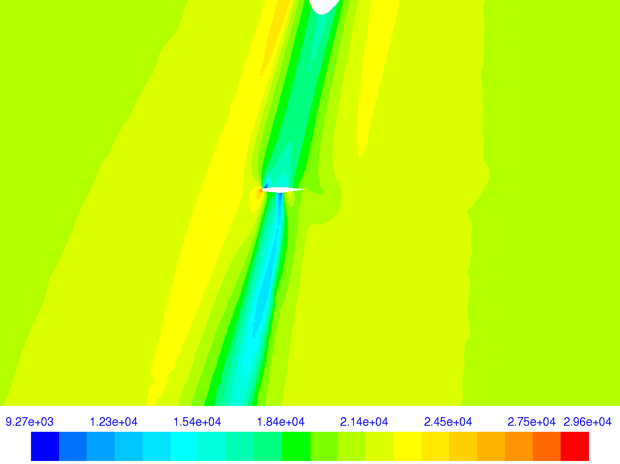
CP (station z0.87)
UdeC - SCB

Slide 36
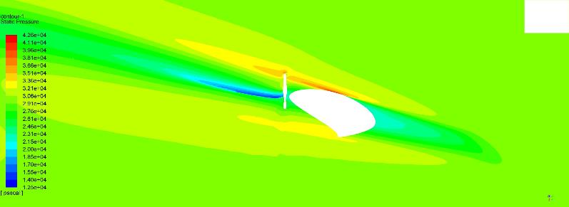
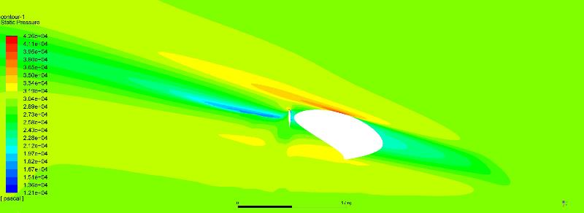
CP (station z1.07)
INCAS
KC
INCAS
SCB

Slide 37
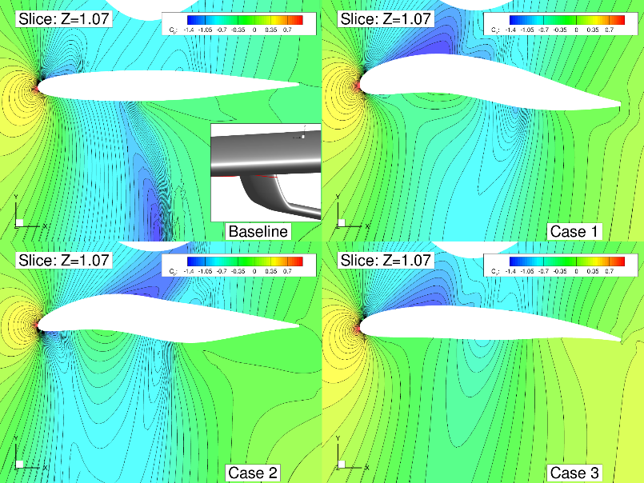
CP (station z1.07)
NASA-AMES

Slide 38
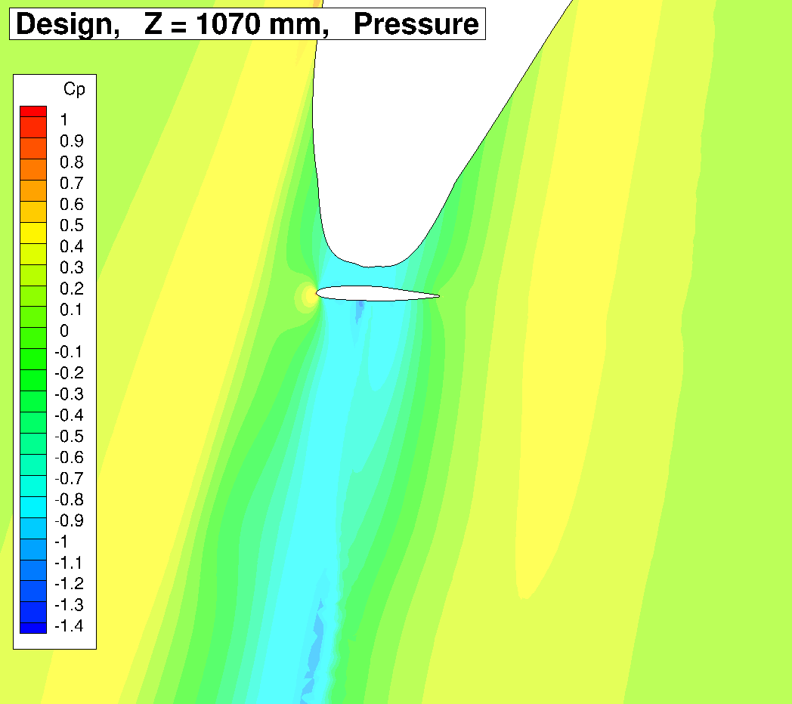
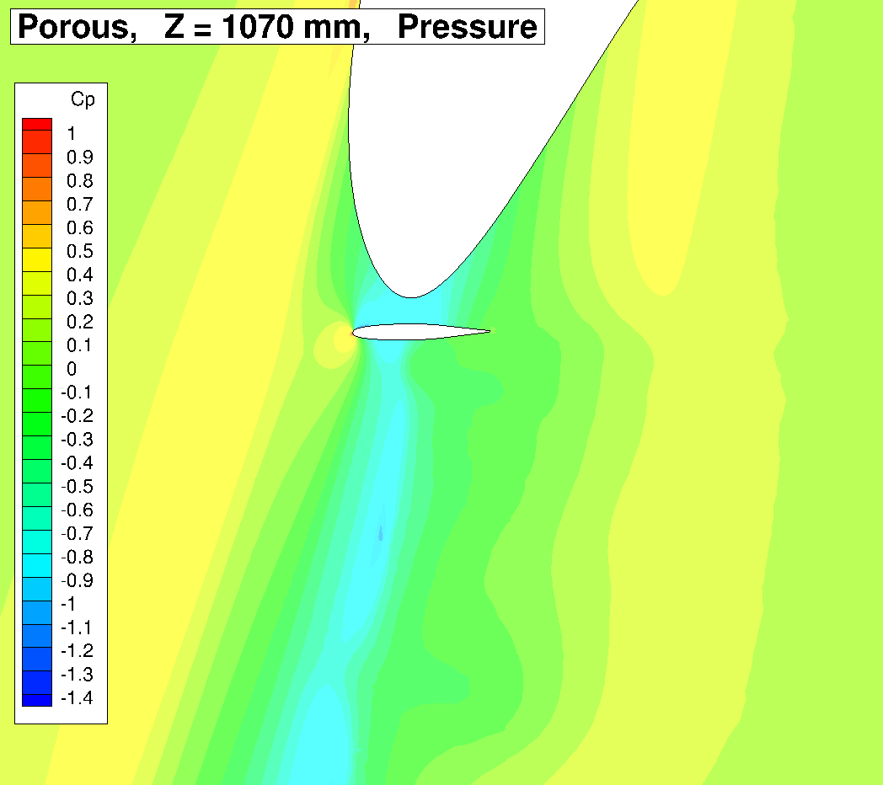
CP (station z1.07)
LANGLEY - Geometry
Porous

Slide 39
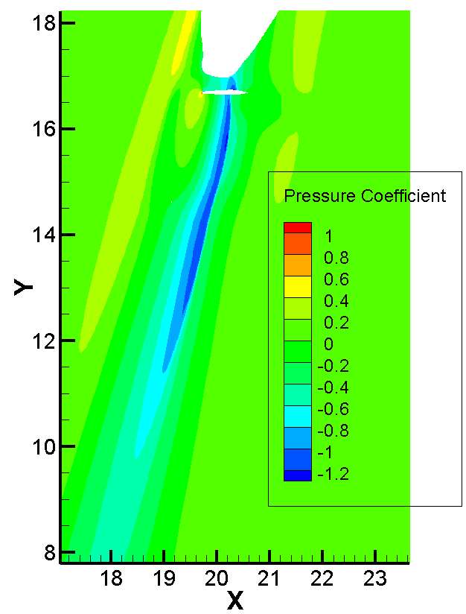
CP (station z1.07)
THU - Geometry

Slide 40
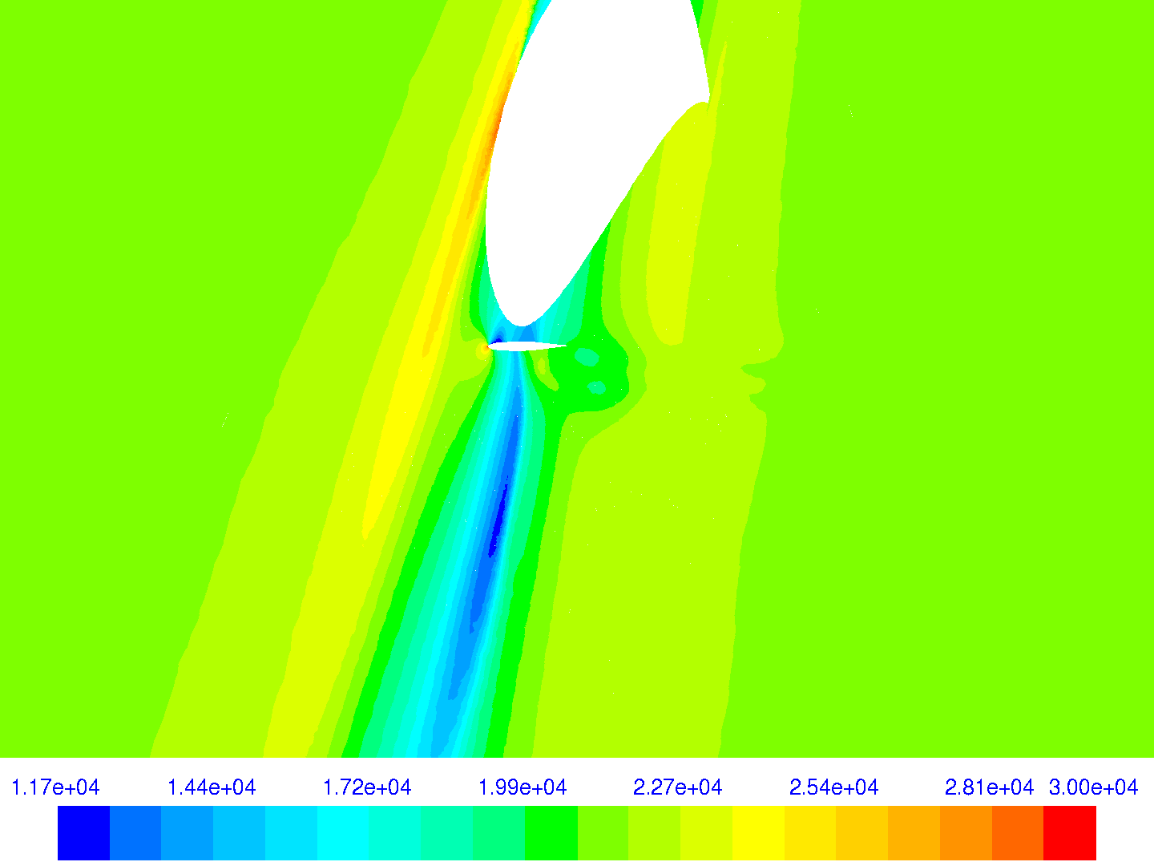
CP (station z1.07)
UdeC - SCB

Slide 41
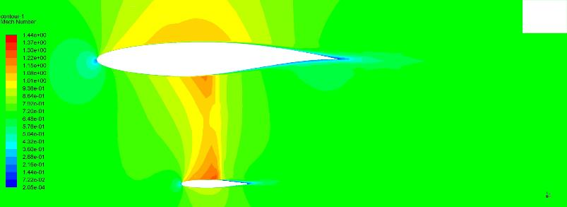
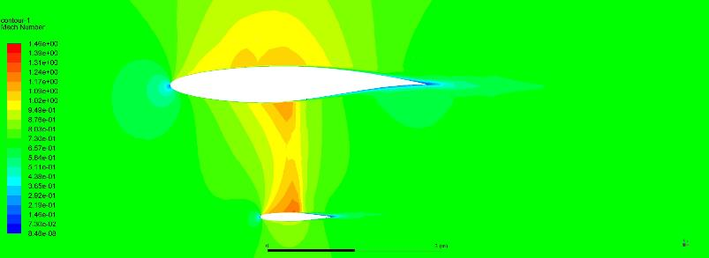
MACH (station y12)
INCAS
KC
INCAS
SCB

Slide 42

MACH (station y12)
NASA-AMES

Slide 43


MACH (station y12)
LANGLEY - Geometry
Porous

Slide 44

MACH (station y12)
THU - Geometry

Slide 45

CP (station y12)
UdeC - SCB

Slide 46


MACH (station y14)
INCAS
KC
INCAS
SCB

Slide 47

MACH (station y14)
NASA-AMES

Slide 48


MACH (station y14)
LANGLEY - Geometry
Porous

Slide 49

MACH (station y14)
THU - Geometry

Slide 50

CP (station y14)
UdeC - SCB

Slide 51


Mach (station y16)
INCAS
KC
INCAS
SCB

Slide 52

mach (station y16)
NASA-AMES

Slide 53


Mach (station y16)
LANGLEY - Geometry
Porous

Slide 54

mach (station y16)
THU - Geometry

Slide 55

MAch (station y16)
UdeC - SCB

Slide 56


Mach (station y17.3)
INCAS
KC
INCAS
SCB

Slide 57

mach (station y17.3)
NASA-AMES

Slide 58


Mach (station y17.3)
LANGLEY - Geometry
Porous

Slide 59

mach (station y17.3)
THU - Geometry

Slide 60

MAch (station y17.3)
UdeC - SCB

Slide 61


Mach (station z0.87)
INCAS
KC
INCAS
SCB

Slide 62

mach (station z0.87)
NASA-AMES

Slide 63


Mach (station z0.87)
LANGLEY - Geometry
Porous

Slide 64

mach (station z0.87)
THU - Geometry

Slide 65

MAch (station z0.87)
UdeC - SCB

Slide 66


Mach (station z1.07)
INCAS
KC
INCAS
SCB

Slide 67

mach (station z1.07)
NASA-AMES

Slide 68


Mach (station z1.07)
LANGLEY - Geometry
Porous

Slide 69

mach (station z1.07)
THU - Geometry

Slide 70

MAch (station z1.07)
UdeC - SCB

Slide 71

www.cimne.com

